Slide 1
New York State Next Generation English Language Arts and Math Learning Standards
Elmira Heights Central School District

Slide 2
Thank you for letting me come in today!
COM OTHER INFORMATION:
Writing Committee
Please be our Guest! We need more MS input!
Overview of the writing plan and goal
Team Time Top 10
Review
Tomorrow During Team Time
We will review Top 10
Focus on 1 of those areas
Share out course information
Roadmap NYSNGLS- Phase I
L Drive (FOLDER- NYSNGLS)
Other- Survey for Digital Literacy

Slide 3
Elmira Heights Central School District: Our Roadmap 2017-2018
2017-2018 –All Elmira Heights Staff will be provided an overview of the NYSNGLS for Math and ELA
2017-2018- All Elmira Heights Staff will be provided the academic vocabulary for the NYSNGLS for Math and ELA
2017-2018- All Elmira Heights Staff will be provided the introduction to the Math and the ELA NYSNGLS documents
2017-2018 –All Elmira Heights Staff will be asked to read through the introduction to the Math and ELA NYSNGLS documents with your grade level team.
2017-2018- All Elmira Heights Staff will be asked to read through the academic vocabulary list with your grade levels, teams, or departments.
2017- 2018- All Elmira Heights Staff will be asked to read through the ELL and Blue Print for students with disabilities individually or with a grade level team or department.

Slide 4
New York State Next Generation English Language Arts and Math Learning Standard
What biases do you have around these four words?
Curriculum | Instruction
Assessment | Standards
Notes:
Poster Board will be listed- each person will do the “volley ball protocol” and identify at least one bias around these words. Those words will then be written down by myself and shared so everyone can see them.
With the many changes in NYS, these bias reflect how others feel across our state. When the commissioner came to NYS, she wanted to change how we feel and change these bias across our state. Before going into these changes I want to first take some time and watch a TED talk video on bias, knowledge and understanding.

Slide 5
New York State Next Generation English Language Arts and Math Learning Standard
Notes:
End of the TED share out thoughts – how difficult is it to unlearn something?
After the video we then will review WHY the changes to the standards in NYS were made again and review HOW these changes will impact students in our state and in our class.

Slide 6
New York State Next Generation English Language Arts and Math Learning Standard
Identify and explain our personal biases around standards, curriculum, assessment, and instruction.
Compare and contrast the backwards brain to the changes with the NYSNGLS

Slide 7
New York State Next Generation English Language Arts and Math Learning Standard
What?
How?
WHY?
WHY did NYS make these changes?
HOW will these changes impact students in our state and in our own classrooms?

Slide 8
Next Generation English Language Arts and
Mathematics Learning Standards
Board of Regents
September 2017

Slide 9
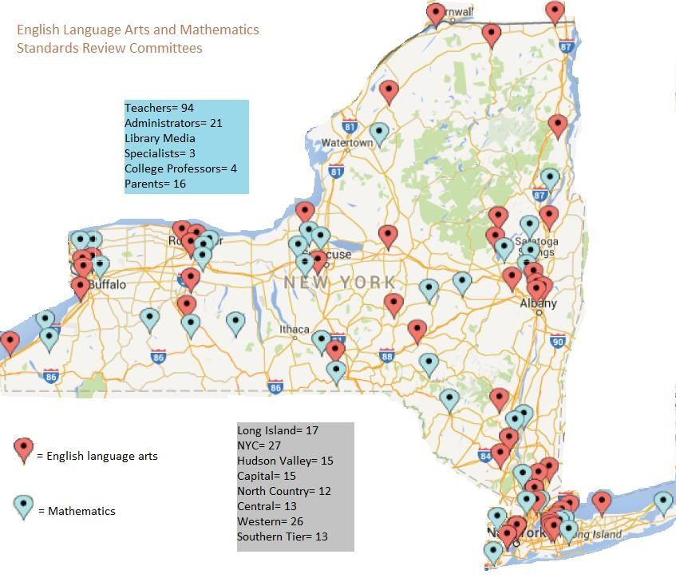
2

Slide 10
The Power of Collaboration
The Mathematics and English Language Arts Leadership teams include members of Staff and Curriculum Development Network (S/CDN), BOCES, NYSUT, and the NYCDOE.
The PTA worked closely with the NYSED teams to select the parent representatives.
The work of the standards review was a collaborative effort.

Slide 11
Highlights of the Revisions of the Mathematics Standards
Type of Revision to the Math Standards | Rationale/Example
Added notes to the standards document Added charts, illustrations, and examples to the standards document | Notes were added to further clarify the meaning of the standard, to clarify the use of the words fluency and explore, to connect the Standards for Mathematical Practice to Mathematical Content, and to cite grade-level/course content connections and attributes along with their reputable research- based mathematical sources such as the Progressions documents. Use of hover over text is incorporated into source information. Charts that were in the appendix were embedded to appear at the point-of-use with each standard it addresses. Illustrations and examples were added to further clarify the meaning of the standard.

Slide 12
Highlights of the Revisions of the Mathematics Standards
Type of Revision to the Math Standards | Rationale/Example
Listed the High School Standards by course Added coherence links to the standards document Added Grade- level/Course specific introductions into the standards document | The high school courses are now listed in the Standards document by course (Algebra I, Geometry, Algebra II) with the standards that make up the course. Coherence linkages connect standards one grade level forward and/or back to the concept addressed. Further links are provided for within-grade connections. Updated/added Prekindergarten-8th grade-level and high school course introductions that highlight the critical areas of focus.

Slide 13
Highlights of the Revisions of the ELA/Mathematics Standards
Type of Revision to the ELA Standards | Rationale/Example
Revised the ELA and Mathematics Introductions to include more information about how the standards apply to English Language Learners/Multilingual Learners and Students with Disabilities | Additional guidance for how to support students with disabilities and English Language Learners/Multilingual Learners has been added to the Next Generation English Language Arts and Mathematics Learning Standards introductions. More resources are forthcoming and will be posted on the NYSED website.

Slide 14
Highlights of the Revisions of the ELA Standards
Type of Revision to the ELA Standards | Rationale/Example
Added English Language Arts Glossary of Terms Added more guidance around the range of reading experiences and text complexity expectations for all grades, Prekindergarten- Grade 12 | To provide more clarification about specific terms used within the ELA Standards, a glossary has been added to provide more guidance and context. For each grade level, reading expectations (including guidance around early and emergent reading experiences in Prekindergarten-Grade 3) have been expanded and clarified to ensure educators and parents understand the reading expectations for each grade level.

Slide 15
Highlights of the Revisions of the ELA Standards
Type of Revision to the ELA Standards | Rationale/Example
Reviewed and revised the Prekindergarten- Grade 3 ELA Standards to ensure they are appropriate for the grade levels | The Early Learning Task Force reviewed the Prekindergarten- Grade 3 ELA Standards in early June and made suggested revisions to several standards per grade for P-3 to address concerns about play and grade-level appropriateness. They also recommended the addition of more guidance and description around reading and writing in the early grades, including text complexity and reading expectations. The importance of play and classroom environment were identified as important areas for future early learning resources.

Slide 16
Highlights of the Revisions of the ELA Standards
Type of Revision to the ELA Standards | Rationale/Example
Created an Early Learning Standards introduction section that provides more guidance around how the standards can be implemented in Prekindergarten- Grade 2 | The Early Learning Standards introduction will provide guidance and context for the standards, as well as guidance around developmentally appropriate practice, teaching all students, cultural appropriateness, and ensuring the needs of students are supported.

Slide 17
Early Learning Introduction
Dr. Zoila Morell
Associate Professor of Educational Leadership, Mercy College
Standards for Learning, not Standardization of Instruction
Setting Standards for Young Children
Protecting Developmentally Appropriate Expectations and Practices Standards and English Language Learners/Multilingual Learners

Slide 18
Next Generation Learning Standards and Assessment Timeline
The projected timeline for standards and assessments over the coming years is:
September 2017: Adoption of Next Generation Learning Standards
Awareness Building 2017-2018 School Year: Two-day assessments measuring the
current standards; professional development on Next Generation Learning Standards;
Capacity Building 2018-2019 School Year: Two-day assessments measuring the current standards; professional development continuing on Next Generation Learning Standards;
Capacity Building 2019-2020 School Year: Two-day assessments measuring the current standards; professional development continuing on Next Generation Learning Standards;
Full Implementation September 2020: Full implementation of the Next Generation
Learning Standards;
Spring 2021: New grade 3-8 tests measuring Next Generation Learning Standards.

Slide 19
Next Steps
Resources/training/professional development
Supporting resources for guidance. For example, grade by grade crosswalks of what is different in the revised standards
Guidance for students with disabilities and English language learners
Development of roadmaps that guide the implementation
process
Ongoing discussions with S/CDN and ELA and Mathematics Professional Development groups to provide resources and guidance to ensure successful implementation

Slide 20
Please complete the “WHAT” handout on the L Drive and turn it in to your building principal.
What?
How?
WHY?

Slide 21
Introduction Documents:
After reading through the documents to the NYSNGLS that are listed on the L Drive please on your own or with your team or department, answer the following for each:
What will curriculum look like in my class?
What will assessments look like in my class?
What will instruction look like in my class?
What will my standards look like in my class?
Has any of my bias’s about these four categories changed? Will I have to unlearn or relearn anything?
Curriculum | Instruction
Assessment | Standards

Slide 22
Other Resources and Information for the NYSNGLS
NYSNGLS Standards and Crosswalk Information- http://www.nysed.gov/next-generation-learning-standards
Elmira Heights PD– L Drive (NYSNGLS folder)
NEXT YEAR (2018-2019) We will LOOK at the crosswalks. If you would like to view them this year, you are welcome to, however this year we are looking at the introductory documents on the L drive and the academic vocabulary.

Slide 23
Questions?

