Slide 1
QFT
Question Formulation Technique
An Instructional Protocol
www.rightquestion.org

Slide 2
What is the Question Formulation Technique?
The Question Formulation Technique (QFT) is a simple, but rigorous, step-by-step process designed to help students produce, improve, and strategize on how to use their questions.
The QFT allows students to practice three thinking abilities in one process: divergent, convergent and metacognitive thinking.

Slide 3
Take two minutes:
“The ability to ask the right questions is probably the greatest talent one can have.”
(p.22) - The Upright Thinkers by Mlodinow
Notes:
What do you think about this? How does it relate to coaching your students to take on the Inquiry process?

Slide 4
How do you teach the art and science of asking the right questions?
John Hattie: Self-questioning and metacognitive strategies
Notes:
John Hattie - Visible learning - Effect size greater than .40 has significant impact on student learning

Slide 5
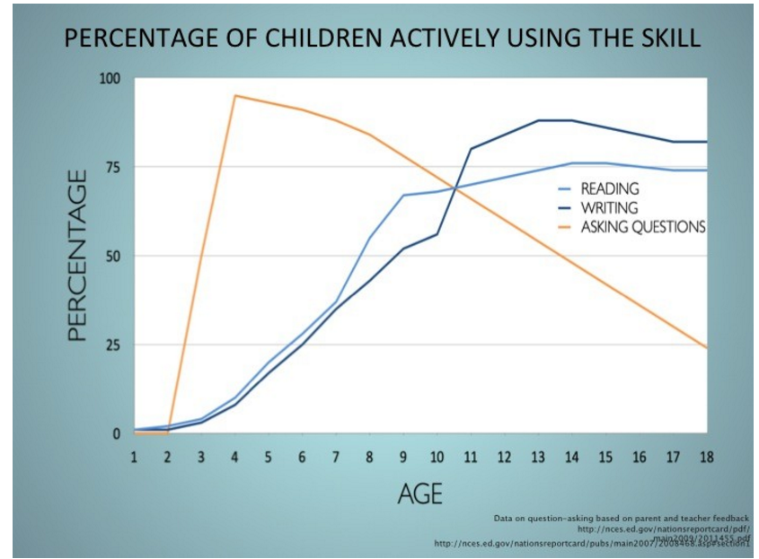
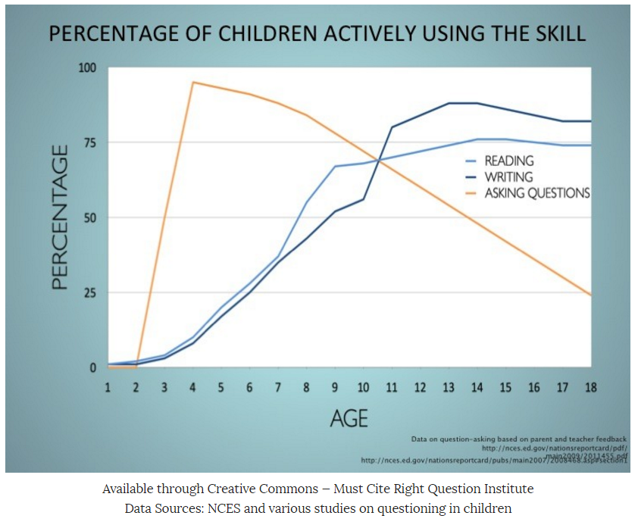
Source: Right Question Institute
Data Sources: NCES and various studies on questioning in children
Notes:
Percentage of Children Asking Questions The skill of question asking is far too rarely deliberately taught in school. In fact, students typically hit their question-asking peak around the age of 4 and their question asking dramatically declines shortly after they enter the classroom. - Right Question Institute

Slide 7
“Knowing the answers will help you in school. Knowing the questions will help you in life.”
-Walter Berger, A More Beautiful Question
Notes:
Parents not knowing what the right questions are, kids not knowing what right questions are. Reference book: Partnering with parents to ask the right questions

Slide 8
Our Work Today:
The Map of The Day
Describe the QFT Protocol
Explain how QFT supports inquiry
Why questions?
“Live “ the QFT Protocol
The Art and Science of QFT
Using QFT in our learning spaces, Examples from colleagues and thinking about our own classroom

Slide 9
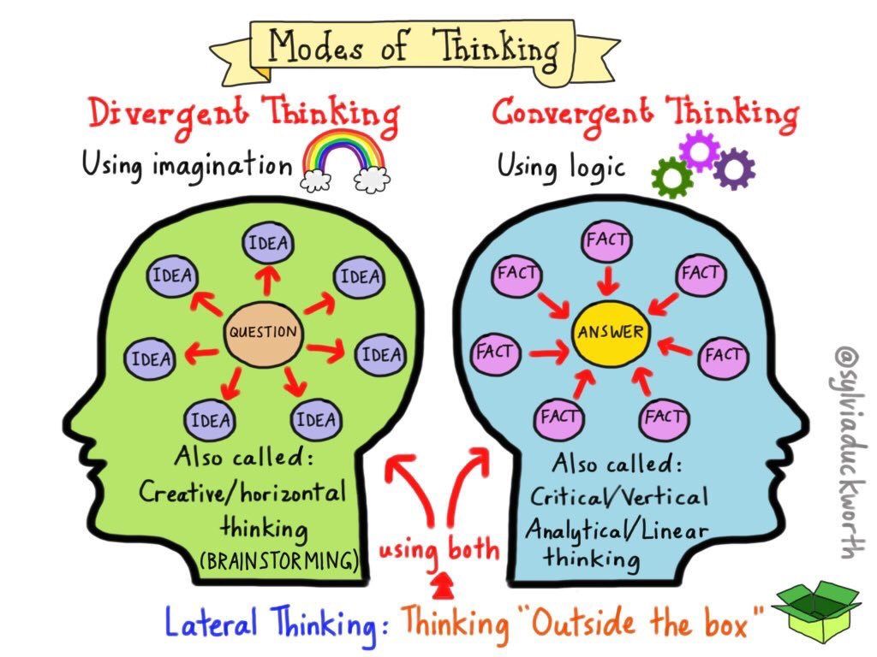
Three Types of Thinking
Convergent: Idea Generation, (single best answer to a defined problem)
Divergent: Idea Analysis (multiple answers to ill defined problems)
Metacognition: Thinking about Your Thinking
Discussion Article:
Convergent vs. Divergent Thinking Video:
Divergent Thinking Video:
Metacognition Video:
Notes:
Partner read: pg. 1-5, What is divergent thinking? What is convergent thinking?
Pg. 5-8: Divergent v. Convergent thinking
Share your learning with your partner
Video: Divergent Thinking

Slide 10
Components of the Question Formulation Technique
1. The Question Focus (QFocus)
2. The Rules for Producing Questions
3. Producing Questions
4. Categorizing Questions
5. Prioritizing Questions
6. Next Steps - Know/Do
7. Reflection

Slide 11
Rules for Producing Questions
Ask as many questions as you can
Do not stop to discuss, judge or answer the questions
Write down every question exactly as it is stated
Change any statement into a question
What might be difficult about following these rules?
Notes:
Divide the room into groups, giving each group materials (poster paper and markers).

Slide 12
Question Focus:
Some students aren’t asking questions.
Follow the Rules for Producing Questions.
Number your questions.
Notes:
Provide chart paper
Assign roles before they start the process

Slide 13
Improve Your Questions
You might have these two kinds of questions in your list:
Closed-ended questions – they can be answered with “yes” or “no” or with one word.
Open-ended questions – they require an explanation and cannot be answered with yes” or “no” or with one word.
Notes:
Categorize – Mark with a “C” or an “O”

Slide 14
Discussion
Closed Ended Questions
ADVANTAGES | DISADVANTAGES

Slide 15
Discussion
Open Ended Questions
ADVANTAGES | DISADVANTAGES

Slide 16
Improve Your Questions
Review your list of questions:
Change one closed-ended question into an open-ended.
Change one open-ended question into a closed-ended one.

Slide 17
Prioritize Your Questions
Choose the three most important questions from your list.
Keep in mind the Question Focus.
Mark each priority question with an “X”

Slide 18
Share Your Questions
Please share with another group:
The questions you changed from closed to open-ended and from open-ended to closed. Read each question as originally written and how it was changed
Your three priority questions
Your rationale for selecting those three
The numbers of your priority questions

Slide 19
Next Steps
How could you use your three priority questions?

Slide 20
Reflection
What did you notice as you worked through the QFT?
What value does the process have?
What are the obstacles (challenges?) to using the QFT in your classroom?
How can the QFT support student learning?
Notes:
4. How can the QFT support student learning (as an alternative)

